Slide 1
CLASS 2 – 11.2.2021
Business Operations Revenue Drivers II –
Ancillary Revenue Generation, Dynamic Pricing, Fanalytics 360-degree view of the fan
Breaks: 5:25pm (5 mins) | 6:15pm (10 mins)
Assignment #1 – Due Nov. 7
Assignment #2 – Due Nov. 14 | Group – avail 7pm
Guest Speaker:
Justin Watkins – Sr. Director, Business Intelligence Atlanta Braves

Slide 2
Course overview
Forecast attendance for an MLB team
Make dynamic pricing recommendations for an NBA team
Create an opening day MLB line-up
Recommend MLS players for re-entry draft
Use Tableau

Slide 3
Notes:
https://www.youtube.com/watch?v=wtJPe1ksS6E

Slide 4


Slide 5
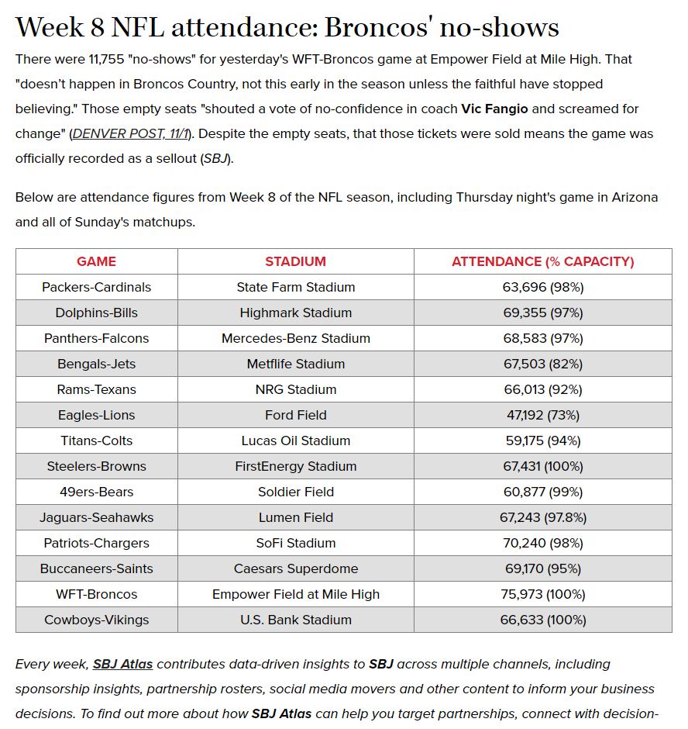

Slide 6
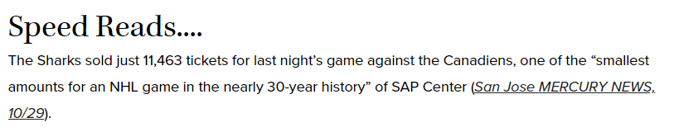

Slide 7
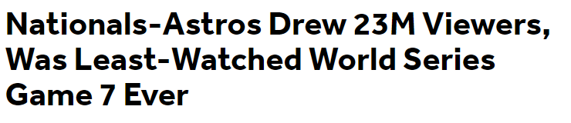
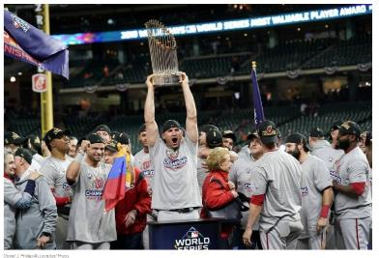
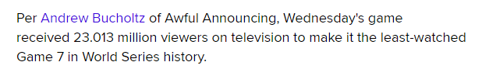
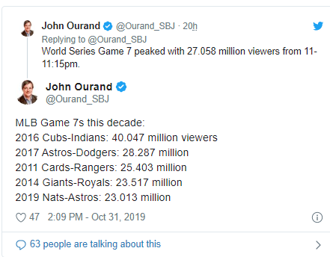
World Series – TV Viewership
Notes:
https://bleacherreport.com/articles/2860732-nationals-astros-drew-23m-viewers-was-least-watched-world-series-game-7-ever?

Slide 8
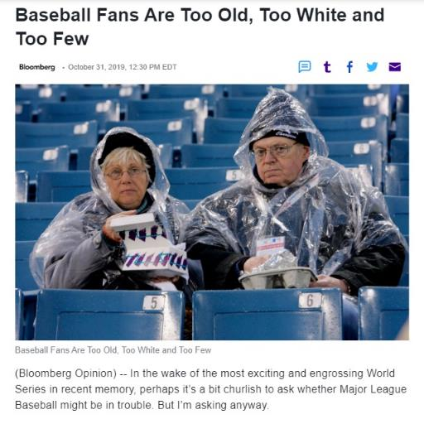
Average baseball television viewer is 57 years old — seven years older than the average pro football fan, and 15 years older than the average pro basketball fan.
Only about 24% of baseball fans are under age 35, compared with 45% of basketball fans. Participation in Little League baseball is plummeting.
Notes:
https://www.yahoo.com/finance/news/baseball-fans-too-old-too-163002757.html

Slide 9
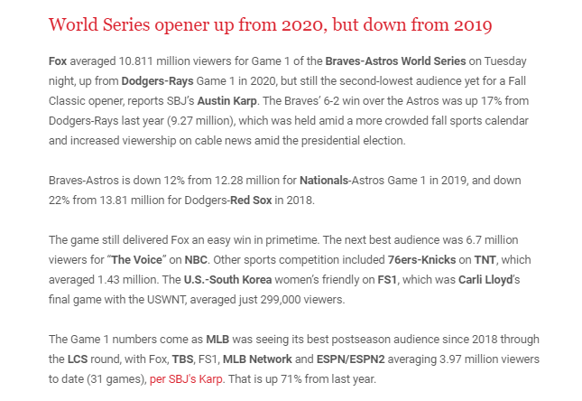

Slide 10
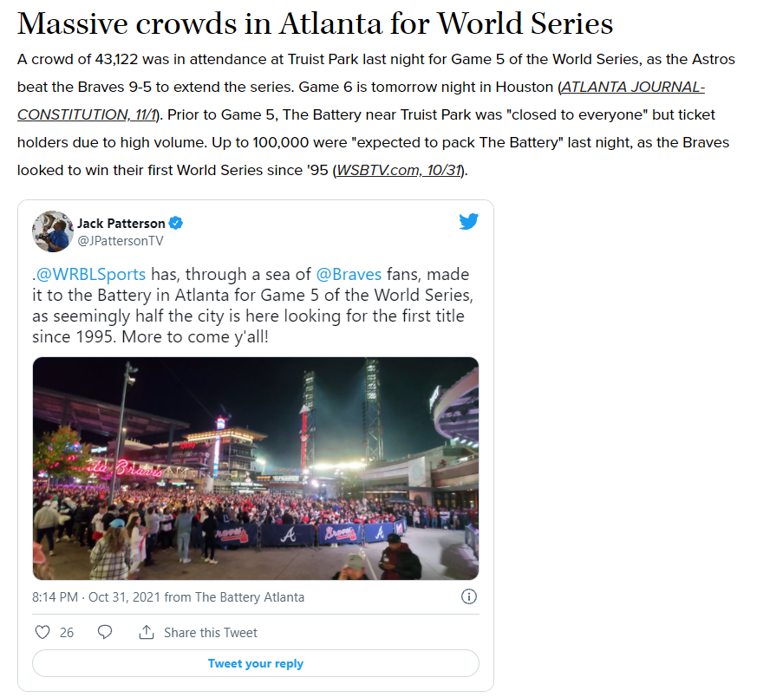

Slide 11
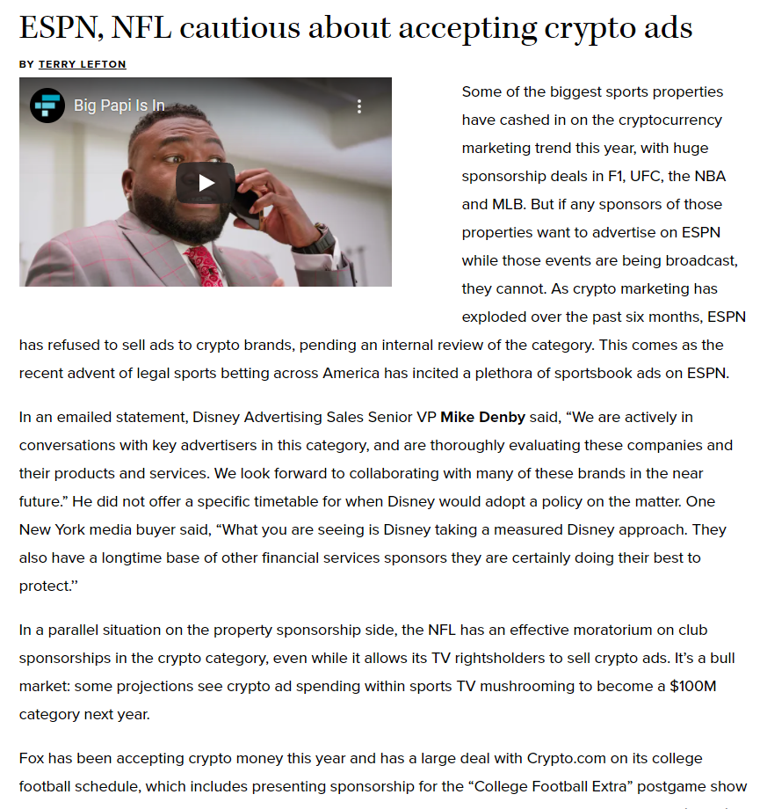

Slide 12
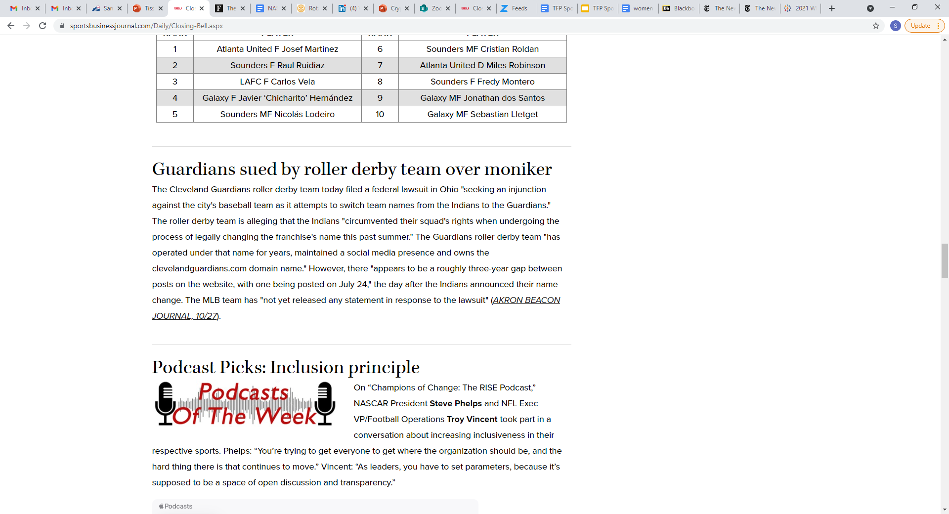
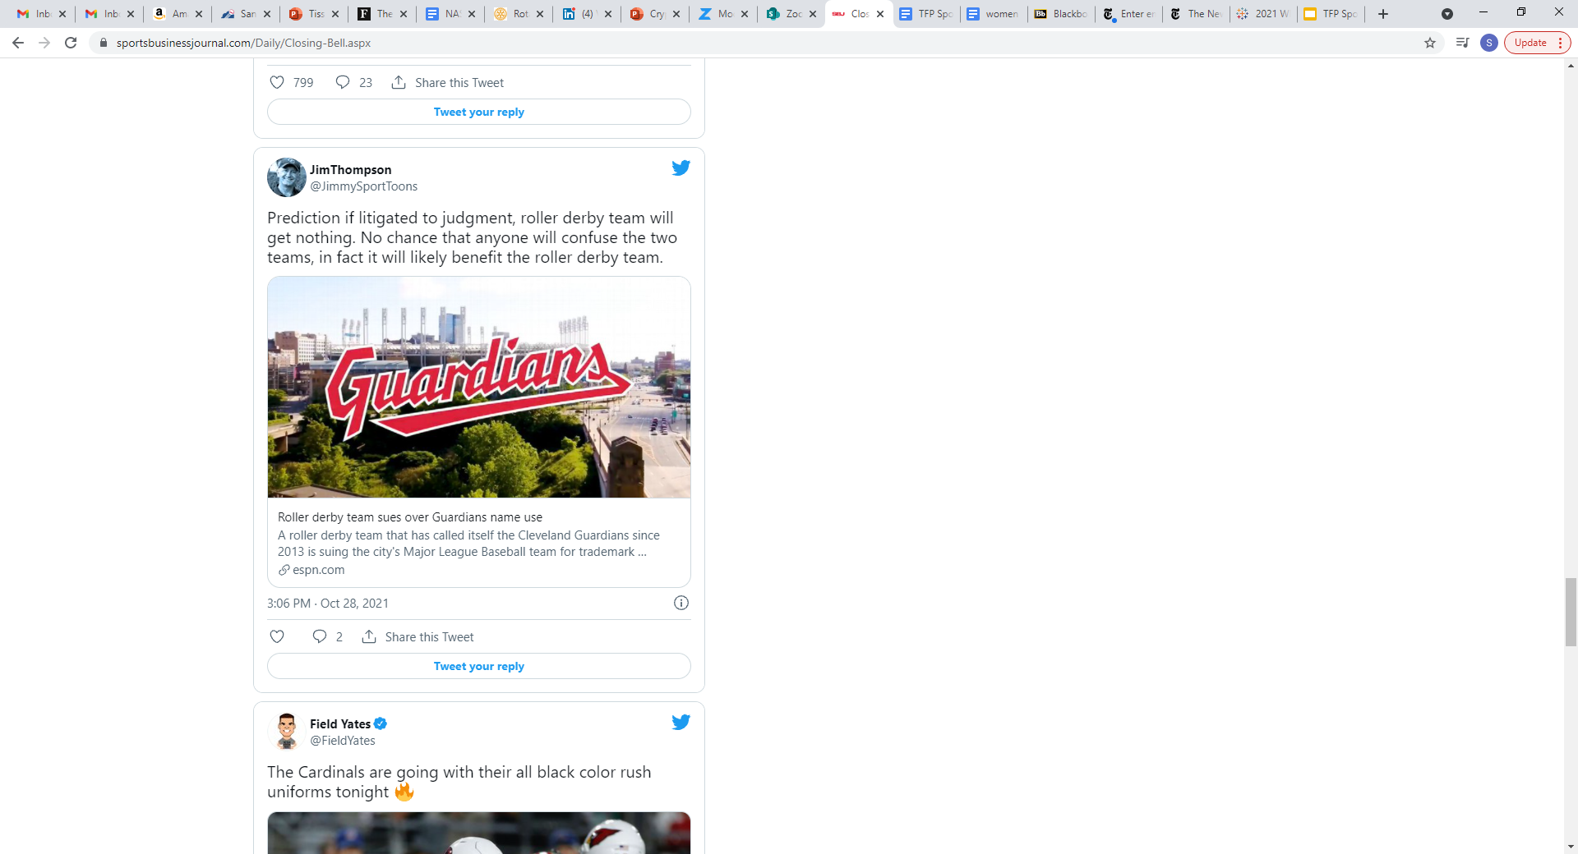

Slide 13
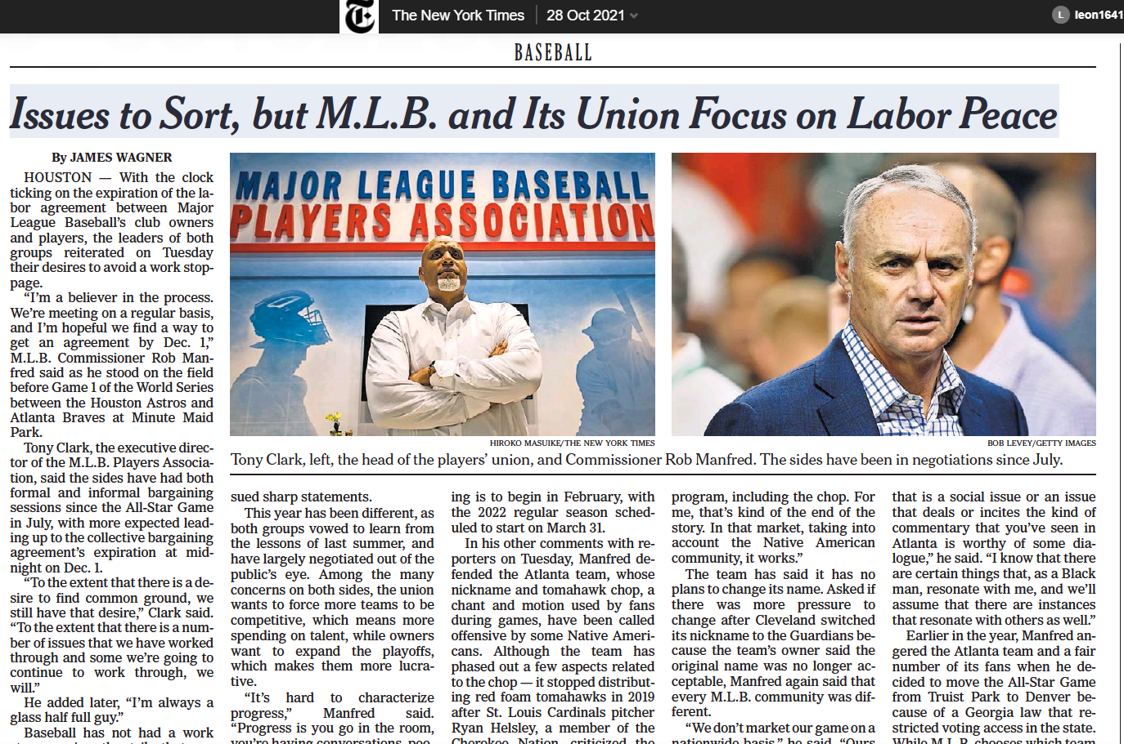

Slide 14
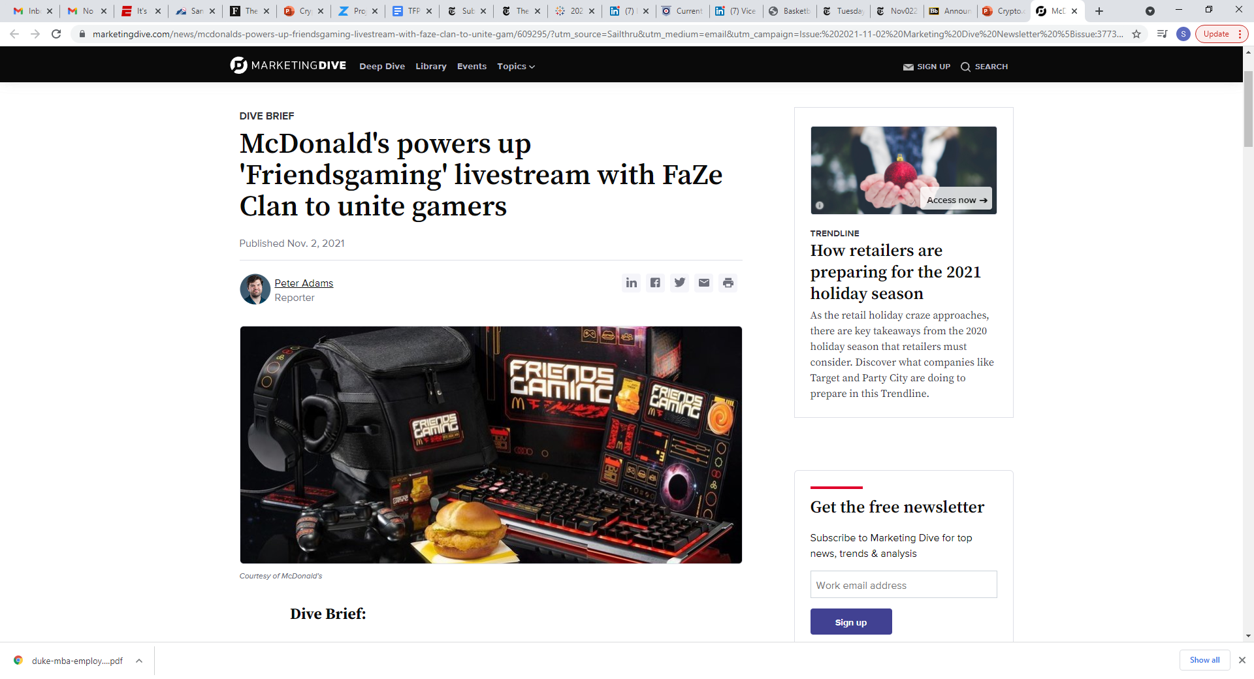

Notes:
https://www.marketingdive.com/news/mcdonalds-powers-up-friendsgaming-livestream-with-faze-clan-to-unite-gam/609295/

Slide 15
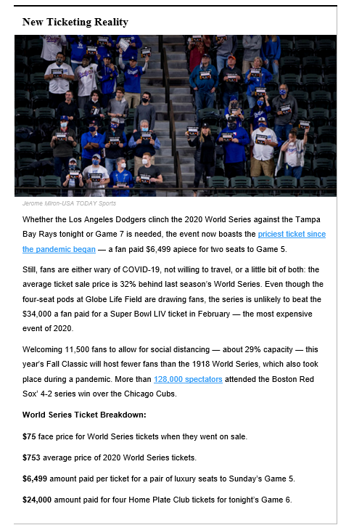
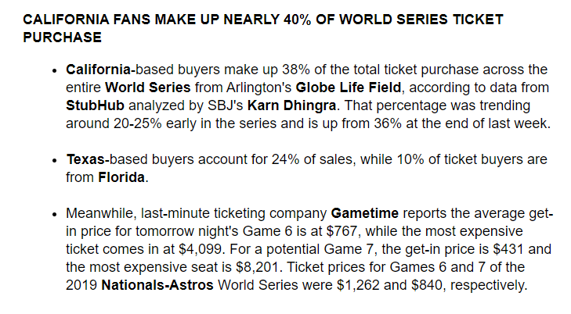
2020 World Series – Secondary Ticket Market

Slide 16
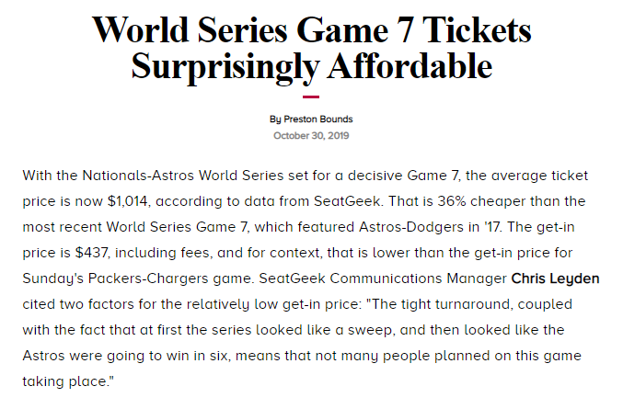
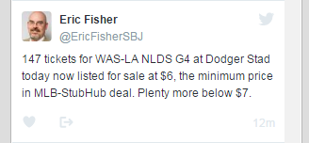
2019 World Series – Secondary Ticket Market
2016
Notes:
https://www.sportsbusinessdaily.com/Daily/Closing-Bell/2019/10/30/Game-7-tix.aspx

Slide 17
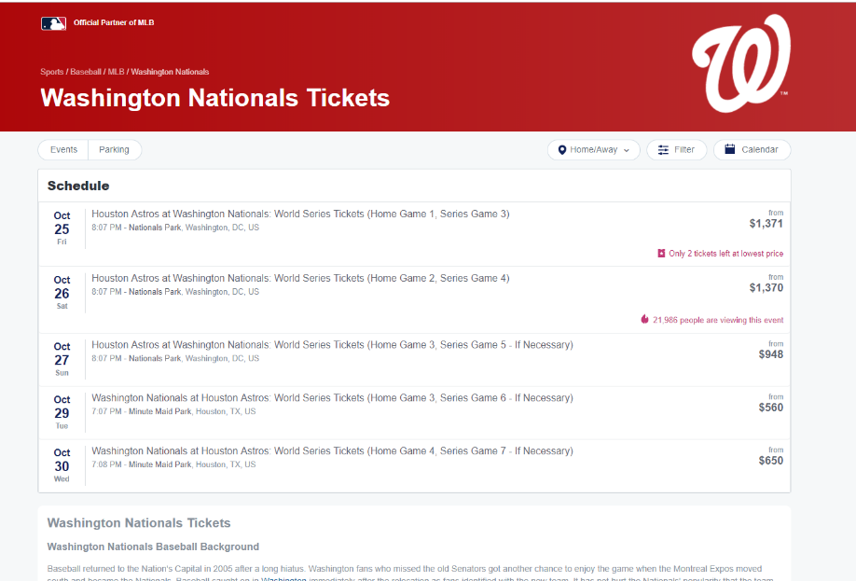

Slide 18
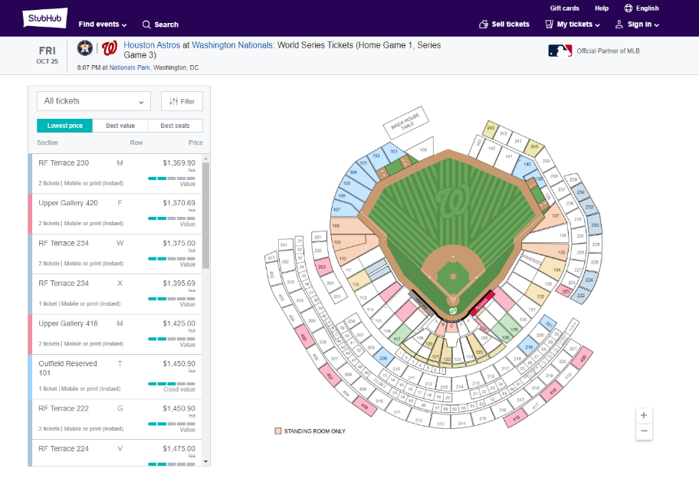

Slide 19
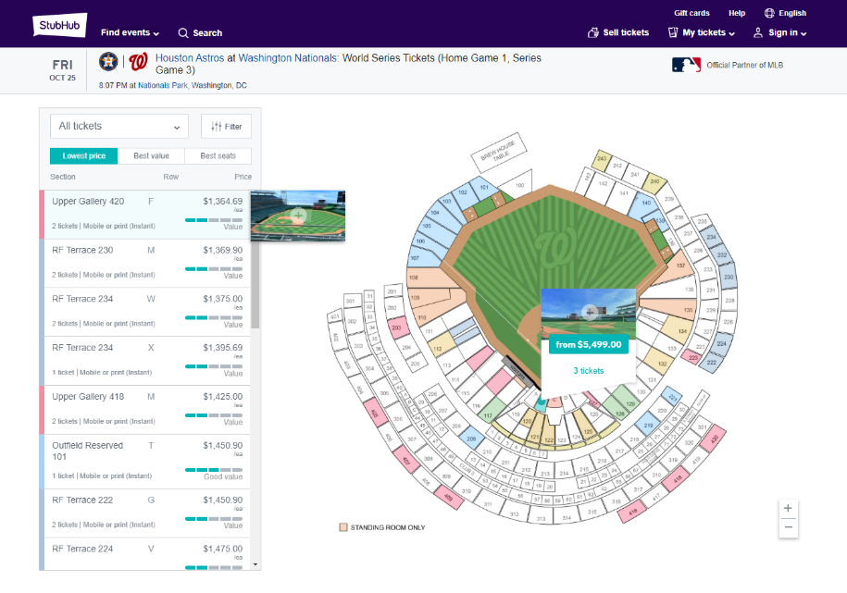

Slide 20
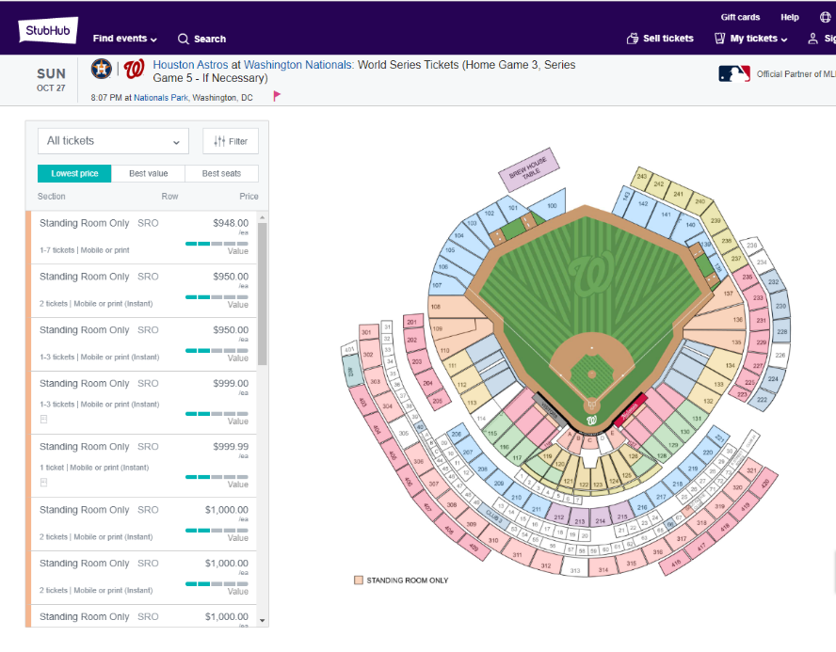

Slide 21
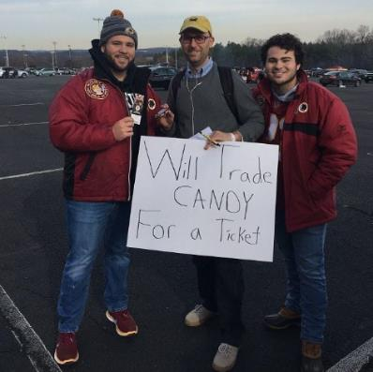
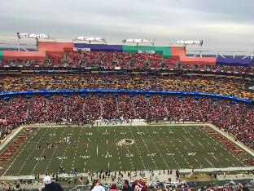
WFT vs. Cardinals – 12.17.17
Wash Football Team
My initial plan was to trade lukewarm Papa John’s pizza for tickets, but I wasn’t in the mood to find lukewarm Papa John’s pizza at 10 a.m. on a Sunday, so on my way to FedEx Field I stopped at a CVS and bought four candy bars, plus a few less appealing snacks: Necco Wafers, a cheese stick, some raisin boxes and a box of Cheerios. I also grabbed some poster board, and when I got to FedEx Field, I created my beautiful sign: “Will Trade CANDY For a Ticket.”
Notes:
https://www.washingtonpost.com/news/dc-sports-bog/wp/2017/12/18/i-traded-a-snickers-bar-for-a-135-redskins-ticket/?utm_term=.c134041e56f1

Slide 22
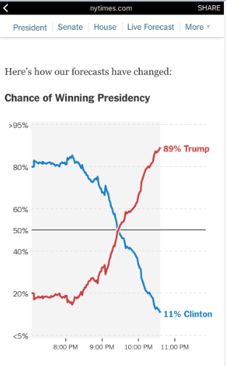
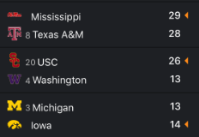
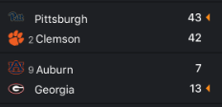
Predictions – one crazy week in 2016
11.8-9.16
11.12.16
-11
-8.5
-24
-20.5
-9.5

Slide 23
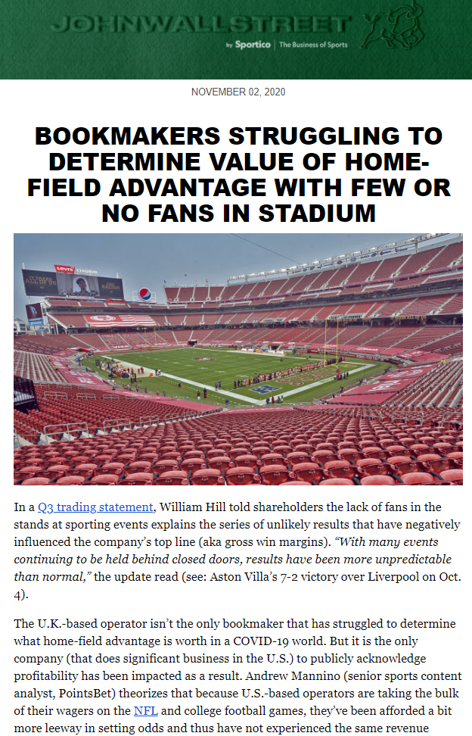
Predictions – uncertainty in 2020
Bookmakers struggle to determine home field advantage. Profitability hurt.
* #1 reason: lack of historical data
* Premier League: restart games – too small a sample size
* “We’re in brand new times. There’s nothing to fall back on but your gut and a good guess.”
* NFL: underestimating over/unders
* Cowboys: first team in nfl history to give up 20+ points in the first half in 6 straight games
* College basketball games present the greatest challenge—and risk—to U.S. bookmakers. Bogdanovich explained, “When you’re dealing with 245 teams, those are games it’s very difficult to make [odds for] and in these COVID-19 times, it’s almost impossible to make a real solid line.”

Slide 24
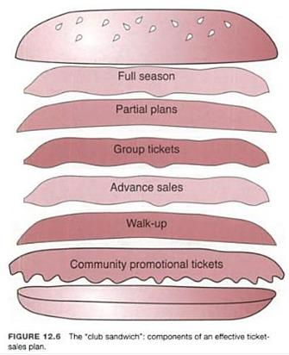
Ticket Sales – the lifeblood of the team business
Sports is a want, not a need – value is more important than price
Team Revenue Drivers:
Tickets
Media Rights
Sponsorships
Signage
Luxury Suites
Merchandise
Concessions
Non-game events (concerts)
Product oriented vs. Consumer driven
Aftermarketing = Relationship marketing = CRM

Slide 25

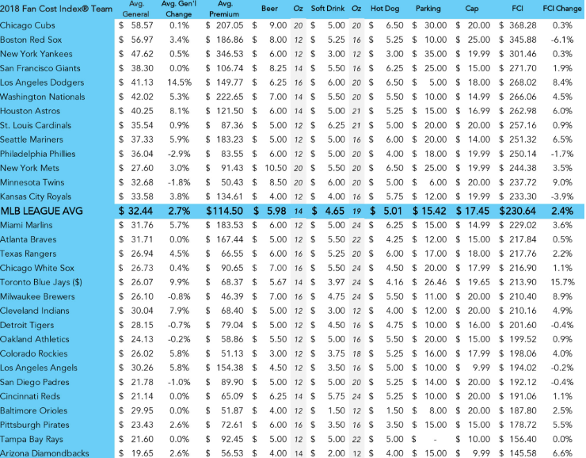
TMR – Fan Cost Index (FCI) – MLB 2018
Notes:
https://www.teammarketing.com/public/uploadedPDFs/MLB-FCI-2016.pdf

Slide 26

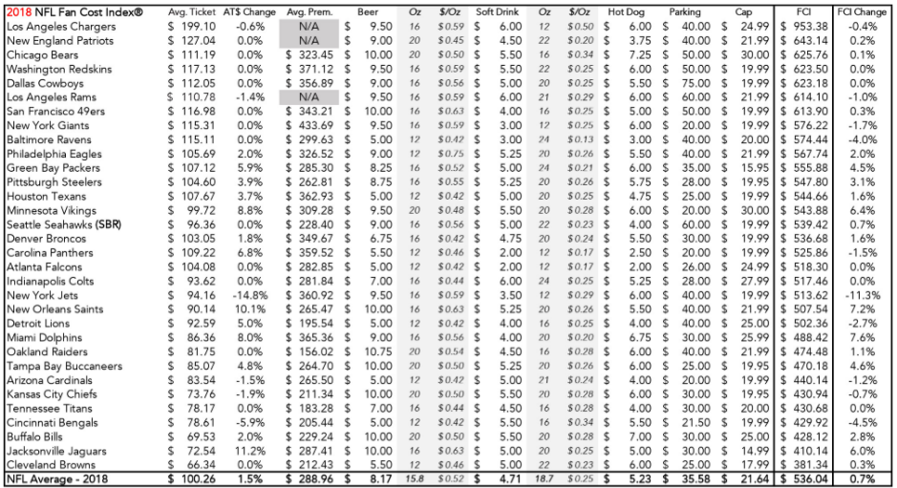
TMR – Fan Cost Index (FCI) – NFL 2018

Slide 27
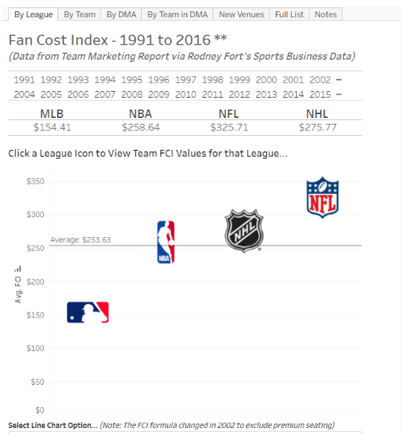
https://public.tableau.com/profile/russell.scibetti#!/vizhome/FanCostIndexAcrossProfessionalSports/ByLeague
Notes:
https://public.tableau.com/profile/russell.scibetti#!/vizhome/FanCostIndexAcrossProfessionalSports/ByLeague
Search New Venue and by Market

Slide 28
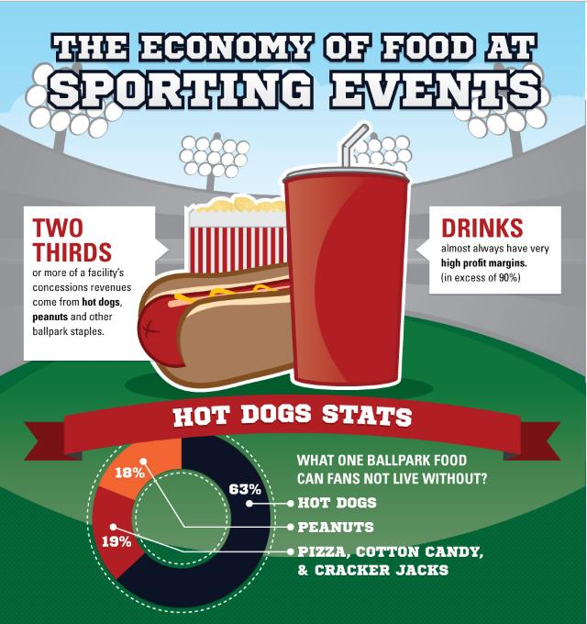
http://www.sports-management-degrees.com/stadium/
Notes:
http://www.sports-management-degrees.com/stadium/

Slide 29
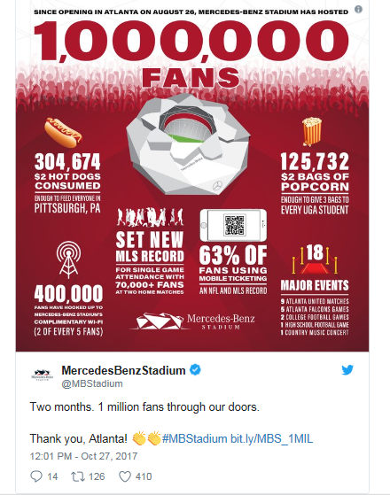
Notes:
http://www.ajc.com/sports/how-many-hot-dogs-bought-mercedes-benz-stadium-first-million-fans/TeFit4na4q0QqKvwGlKrXL/

Slide 30

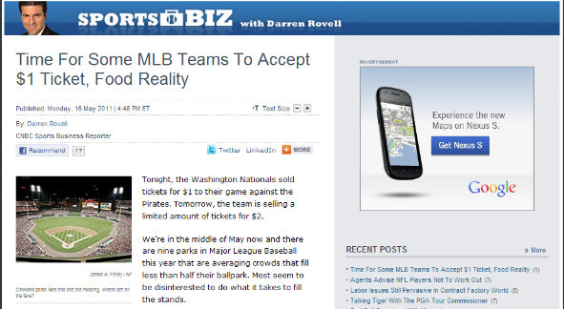
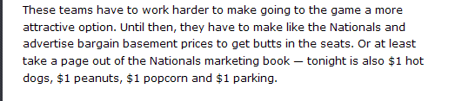
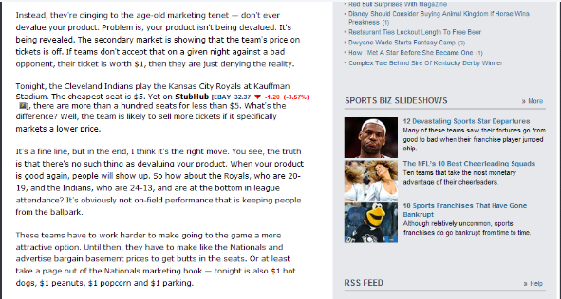
Notes:
http://www.cnbc.com/id/43051567

Slide 31
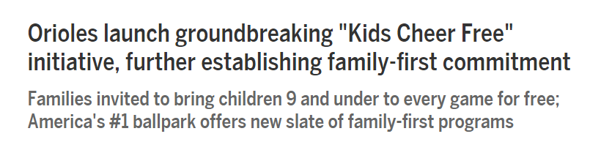


Slide 32
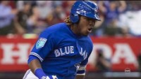


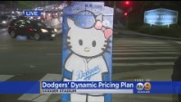
MLB PRICING NEWS - 2018
Notes:
https://www.youtube.com/watch?v=vc9v0iZhiqU
https://www.youtube.com/watch?v=3QI20CeJRJY

Slide 33
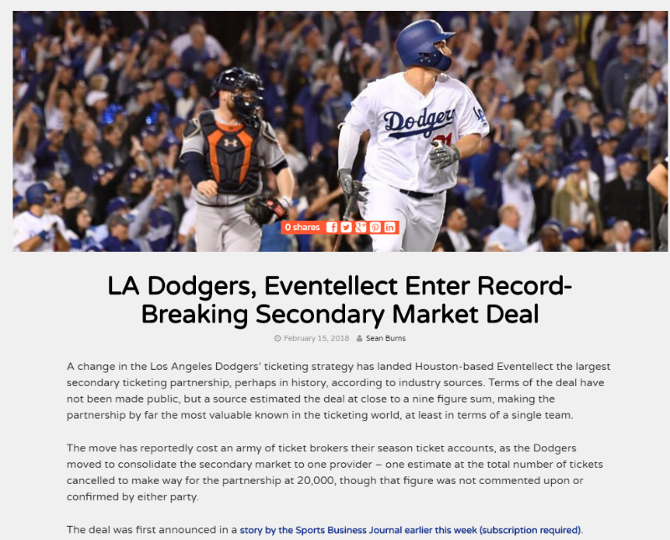
Notes:
https://www.ticketnews.com/2018/02/la-dodgers-eventellect-record-breaking-deal/

Slide 34
TICKET PRICING

Slide 35
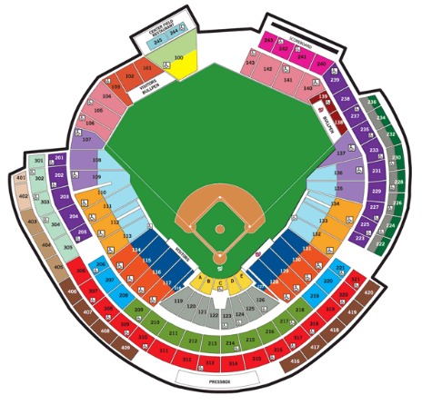
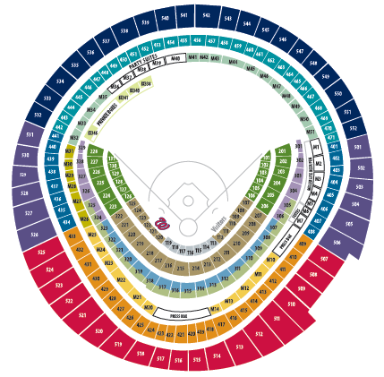
Pricing to budget/cost
RFK STADIUM - 2007
NATIONALS PARK - 2008
Reference Point

Slide 36
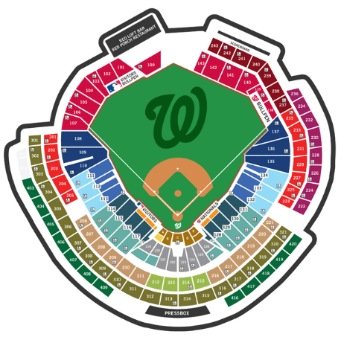
Pricing to demand - price scale consolidation
NATIONALS PARK - 2008
NATIONALS PARK – 2015/Current

Slide 37
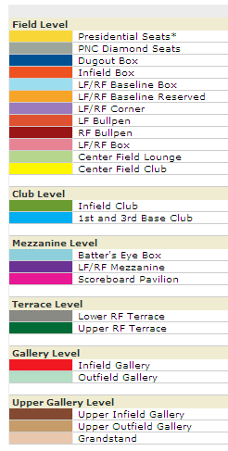
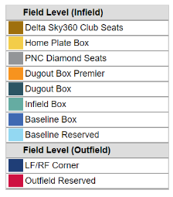
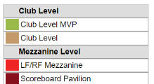
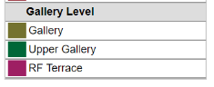
NATIONALS PARK - 2008
NATIONALS PARK - 2015

Slide 38
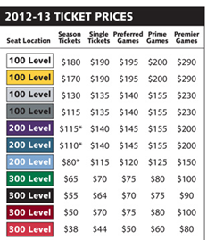
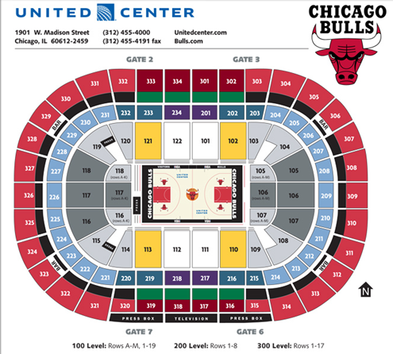
Traditional – Static/Variable – Fair Price
Notes:
http://www.nba.com/bulls/tickets/seating.html

Slide 39

ORIOLES – VARIABLE TICKET PRICING

Slide 40


Notes:
http://www.stubhub.com/chicago-bulls-tickets/chicago-bulls-chicago-united-center-11-18-2013-4335542/

Slide 41


Slide 42

Notes:
http://www.sportsbusinessdaily.com/Journal/Issues/2016/02/08/Marketing-and-Sponsorship/StubHub.aspx

Slide 43

www.stubhub.com/sixers
Notes:
www.stubhub.com/sixers

Slide 44


Slide 45


BUCKS vs. KNICKS – 11.5.21
https://www.ticketmaster.com/milwaukee-bucks-vs-new-york-knicks-milwaukee-wisconsin-11-05-2021/event/07005B1A9CA213F4
Notes:
https://www.ticketmaster.com/milwaukee-bucks-vs-new-york-knicks-milwaukee-wisconsin-11-05-2021/event/07005B1A9CA213F4

Slide 46

Dynamic – Market Demand Airline Pricing Needs vs. Wants

Slide 47

Dynamic – Online Retail
Notes:
http://www.nytimes.com/interactive/2012/12/01/business/how-online-retailers-play-with-pricing.html?ref=business

Slide 48

Opting for fairness in the marketplace vs. raising price to match demand to instill loyalty.
Artists & promoters leave 5% of potential income ($200M) on the table by underpricing tickets relative to market rate. No discounting
Variable/Dynamic Pricing:
Bruce on Broadway: $75-$850 | $1,200 to $9,999 on Stubhub
Electricity: Costs 4-5x during peak heat waves
Home Depot: Price freezes in places hit by Hurricanes
Beltway Toll Lanes: 20c/mile vs. $1/mile
DC Metro Peak fares: $4.45 vs. $3.65
Uber surge pricing (2.5x)
London City congestion pricing $18
Notes:
https://www.nytimes.com/2017/10/14/upshot/why-surge-prices-make-us-so-mad-what-springsteen-home-depot-and-a-nobel-winner-know.html?_r=0

Slide 49

SF GIANTS – DYNAMIC TICKET PRICING
Source: NY Times

Slide 50



Notes:
http://www.amazinavenue.com/2011/10/4/2468928/mets-announce-season-ticket-pricing-and-introduce-dynamic-pricing-to

Slide 51






Notes:
http://www.sportsbusinessdaily.com/Journal/Issues/2012/10/29/Franchises/Giants-tickets.aspx
http://www.cnbc.com/id/48194739
http://www.nytimes.com/2009/05/18/sports/baseball/18pricing.html?_r=0

Slide 52

Notes:
http://www.nba.com/timberwolves/wolvestix

Slide 53

Dynamic – Communication

Slide 54

Notes:
http://prices.miamiheattix.com/novembermhis
The NBA is easing up on player resting policies for non-nationally televised games during the 2020-21 season, but reaffirmed it will still fine teams at least $100,000 for resting any healthy player for nationally televised games.
Pop’s Play: Resting first became a hot topic in 2012 when the San Antonio Spurs were fined $250,000 after head coach Gregg Popovich let Tim Duncan, Manu Ginobili, Tony Parker and Danny Green sit out of the team's primetime matchup with LeBron James’ Miami Heat.
The issue was reignited in the 2018-19 campaign due to the Toronto Raptors’ “load management” plan for Kawhi Leonard. The league later said that that term fell under the same resting rules.
Veteran Priority: Examples provided in a memo Monday for uses of the new rule include resting a “key veteran player who played a substantial role on a team that advanced deep into the 2020 Playoffs,” or to rest a player who is still returning to full strength after recovering from COVID-19.
The move should appeal to stars like James, who played until mid-October in the bubble, and expressed concerns about the next season starting just over two months later.
The 71-day break from the conclusion of the NBA Finals to opening night on Dec. 22 will mark the shortest offseason in the history of the NBA. An average offseason is usually about 155 days.
Teams have also been told not to rest multiple healthy players for the same game or rest healthy players on the road except for in “unusual circumstances.” In situations when teams decide to rest a healthy player, the league wants that player to be visible to fans.

Slide 55


LA Clippers
Notes:
http://www.nba.com/raptors/tickets/single-game/dynamic-pricing
Clippers: https://vimeo.com/86926033

Slide 56


Slide 57


Slide 58


Dynamic Pricing – Static Messaging
Notes:
http://www.washingtonpost.com/sports

Slide 59
Data Sources – Ticket Pricing
Inventory & Primary Sales Channel:
Seating Capacity
Tickets Sold/Distributed vs. Unsold
Ticket Holds
Run-up/Trends
Seating area trends
Secondary Market:
Tickets listed for resale
Tickets re-sold to date
Listing price – average vs. typical
Average yield
Floor/Get-in price vs. Ceiling
Game Related:
Match-up/Opponent/Key Player(s)/Pitching match-up
Opener/Holiday/Playoffs
Month/Day of Week/Time
Promo giveaway
Frequency of Games
Weather
Historical trends

Slide 60


Staples Center - NBA
Notes:
http://conormclaughlin.net/2019/11/ticket-prices-for-the-lakers-and-clippers-at-the-staples-center/

Slide 61

Assignment #2

Slide 62

Dynamic Pricing Engine - Stratbridge
Notes:
Site: insight2.stratbridge.com (no www. needed)
Username: sports-analytics@gwu.edu
Password: YftNyQczrR

Slide 63


Slide 64

https://insight.stratbridge.com/login?next=/
Notes:
https://insight.stratbridge.com/login?next=/

Slide 65


Slide 66


Slide 67


KPI: Elasticity of Demand
,

Slide 68


NBA – Elasticity of Demand Models
Cleveland Cavaliers:
* ‘05-’06: Lost in Eastern Conf Finals (2nd Rd)
* ’06-’07: Lost in NBAFinals
Charlotte Bobcats (Hornets):
* ‘05-’06: 26-56, tied for worst record in Eastern Conference
* ’06-’07: 33-49, 4th place in Southeast Division

Slide 69

Failure to price strategically can have long term ramifications
Notes:
http://espn.go.com/blog/playbook/dollars/post/_/id/2081/white-sox-listen-to-fans-slash-prices

Slide 70


Notes:
http://www.nj.com/yankees/index.ssf/2009/04/new_york_yankees_cut_ticket_pr.html

Slide 71

Notes:
https://sports.theonion.com/slashed-ticket-prices-allow-lesser-nobility-to-attend-y-1819570733

Slide 72

Attendance:
2016 series vs. Cubs:
37,187 | 41,955 | 42,000
2017 series vs. Cubs:
29,651 | 31,202
31,072 | 37,097
Dugout Box Seat: $140 ($90)
Terrace Seat: $35 ($12)
“I’d rather watch it on TV from my couch,” Harper said, deadpanning a bit. “That MLB plan is pretty good. Great coverage.”
By pricing the Cubs tickets the way they did, that’s essentially the message the Nationals sent to their fans.
Notes:
https://www.washingtonpost.com/news/dc-sports-bog/wp/2017/06/29/did-the-nationals-price-themselves-out-of-sellouts-for-the-cubs-series/?utm_term=.ec4c6c48dcf5

Slide 73

U.Minn- Multi-game offer
Notes:
http://espn.go.com/blog/playbook/dollars/post/_/id/2402/minnesota-lets-you-gamble-with-ticket-deal

Slide 74


Northwestern – Dutch Auction
https://www.youtube.com/watch?v=9NoHM3OVzs4
Notes:
http://www.chicagobusiness.com/article/20130729/BLOGS04/130729812/northwestern-using-purple-pricing-for-football-tickets#

Slide 75


Stanford – Predictable Dynamic Pricing
Notes:
http://espn.go.com/college-football/story/_/id/9505857/stanford-cardinal-introduce-progressive-ticketing
http://www.gostanford.com/ViewArticle.dbml?&&&DB_OEM_ID=30600&ATCLID=208769460

Slide 76



Notes:
http://www.latimes.com/business/la-fi-agenda-dynamic-pricing-20160314-story.html

Slide 77


Notes:
http://insideuniversal.net/2015/12/universal-studios-hollywood-introduces-dynamic-ticket-pricing-with-discounts/

Slide 78

Notes:
http://www.sportsbusinessdaily.com/Journal/Issues/2017/10/30/Leagues-and-Governing-Bodies/MLB-StubHub.aspx

Slide 79



2/23/13
Notes:
http://www.espn.com/blog/new-york/mets/post/_/id/61415/study-compares-mets-stubhub-prices

Slide 80


http://blog.tiqiq.com/2016/11/cubs-world-series-ticket-prices/
Prices for Game 7 World Series Tickets in Cleveland Down 33% Following Game 6

Slide 81


Fanalytics – 360 degree view of the fan

